Slide 1
Project Presentation
VIDEO COMPRESSION USING
COLOR IMAGE QUANTIZATION
SHREY SHARMA 19JE0788
SHUBHAM JAMUAR 19JE0794

Slide 2
Problem Statement
In this era of internet and social media, sharing and storage of multimedia files like images, videos, etc. have become very prevalent. It has led to a major challenge of storing these files as they require large amount of space.
One way of addressing this problem is to reduce the size of the file with little subjective degradation.
One way of achieving this goal is to use Colour Image Quantization.
Our main aim is to apply this concept to video files with temporal compression techniques. As Colour Image Quantization applies to images and also we know that video files are collection of images. Hence, we first need to apply this principle to each frame of video independently.

Slide 3
Basics of Image
An image can be considered as a three dimensional matrix(w x h x c) where w is width of image, h is height of image and c corresponds to number of channels which is equal to 3 in case of RGB image.
Hence, each pixel of the image can be represented by a tuple (x_{r} , x_{g}, x_{b}), where the x_{i} are color component values for red, green and blue respectively.
The color components are usually represented by numbers in the range [0,255] which requires 8 bit per color component respectively, hence corresponding to 24 bits per pixel.
Total size of an image can be said as 3 * w * h bytes.

Slide 4
COLOR IMAGE QUANTIZATION
Quantization is the process of assigning representation values to ranges of input values. We apply the same process to images/videos in the form of Color Image Quantization, where we do the following steps:
Determining the color statistics for the input image
We convert the given image into a numpy array in order to obtain the pixel values.
Determining the optimal colormap for the distribution
To convert the original image into quantized image we need to form a colormap, which is an optimal set of colors which can represent the entire image.

Slide 5
We need a measure to determine quantization error between the original pixel value and quantized pixel value. For this purpose we choose the Euclidean distance function to be the measure of quantization error. Total quantization error is defined by the sum of all individual quantization errors.
TQE = Σi,j D(c_{i,j} , q(c_{i,j}))
where q is the mapping function from original pixel to its quantized value and i,j denote the pixel co-ordinate in the image and D denotes the Euclidean Distance function
In order to minimize this error, we apply K-means clustering on the pixel values to choose an optimal colormap.

Slide 6
The following stages will help us understand how the K-Means clustering technique works-
Step 1: First, we need to provide the number of clusters, K, that need to be generated by this algorithm.
Step 2: Next, choose K data points at random and assign each to a cluster. Briefly, categorize the data based on the number of data points.
Step 3: The cluster centroids will now be computed.
Step 4: Iterate the steps below until we find the ideal centroid, which is the assigning of data points to clusters that do not vary.

Slide 7
4.1 The sum of squared distances between data points and centroids would be calculated first.
4.2 At this point, we need to allocate each data point to the cluster that is closest to the others (centroid).
4.3 Finally, compute the centroids for the clusters by averaging all of the cluster’s data points.
Once the convergence is reached, the obtained centroids denote the representative color for its corresponding cluster.
Hence, the collection of these representative colors is known as colormap.
Redrawing the image to form quantized image
We replace c_{i,j} in the image matrix with the index of q(c_{i,j}) in colormap i.e. the nearest representative of c_{i,j} obtained from the colormap

Slide 8
PROGRESS REPORT
First of all, we went through the basics of color image quantization and the steps required.
We went through several texts to know more about the optimal method to determine the colormap.
We chose k-means algorithm as the most optimal and feasible way to obtain the colormap.
We went through various ways to optimally assign the nearest representative to any pixel value.
We implemented the code and found the following results:
The original image size was 738KB (.jpg format) which was reduced to 216KB (.jpg format) by using only 8
colors. The resultant image is shown below.

Slide 9
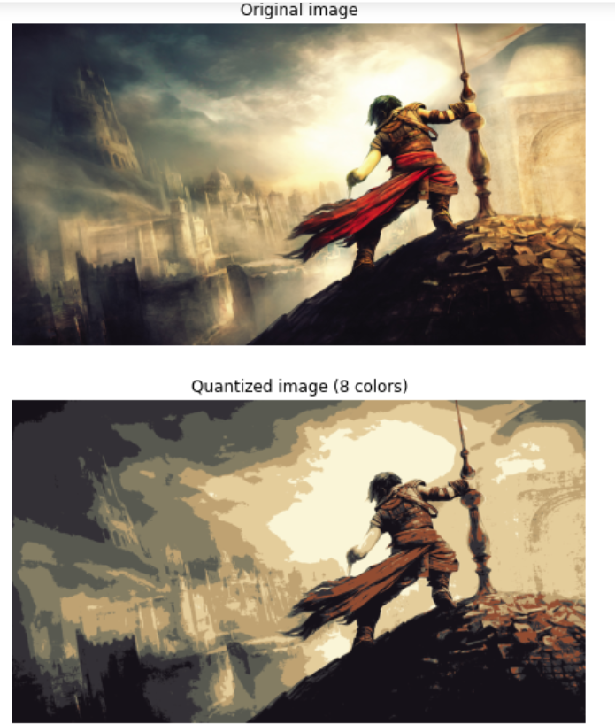

Slide 10
FUTURE WORK
Spatial Compression on video –
We would apply the technique we used to compress the image on video file to obtain color image quantization on each frame.
Temporal Compression on video –
We will learn techniques to compress video further by studying relationship between neighbouring frames i.e. by eliminating the redundant parts of neighbouring frames.
Use Raspberry Pi to perform color image quantization on live video –
Raspberry Pi can be used to capture live video and perform color image quantization on the obtained video

